Slide 1
Heating and Stirring Module Design Review #6

Slide 2
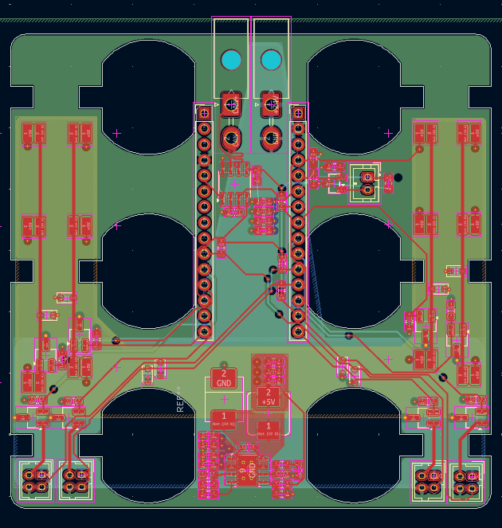
Heating & Stirring PCB
CAN-BUS Transceiver with dual power supplies
Fan control via PWM
Housing temperature sensing, via thermistor.
Motor flyback diodes.
> 6 Layer PCB?

Slide 3
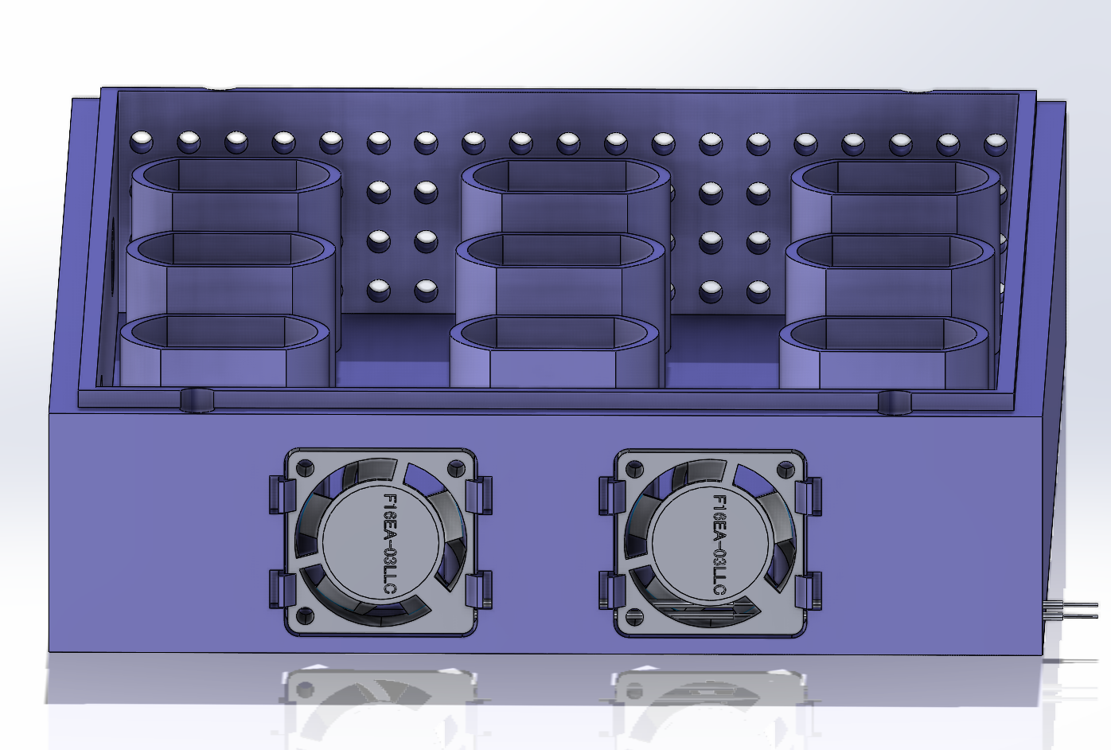
Heating and Stirring Module Fans
F16EA-03LLC, 3.3V Fan, $9.67.
Lower cost alternatives available, require resizing of housing.
Requires PWM control and internal temperature sensing for efficient application.

Slide 4
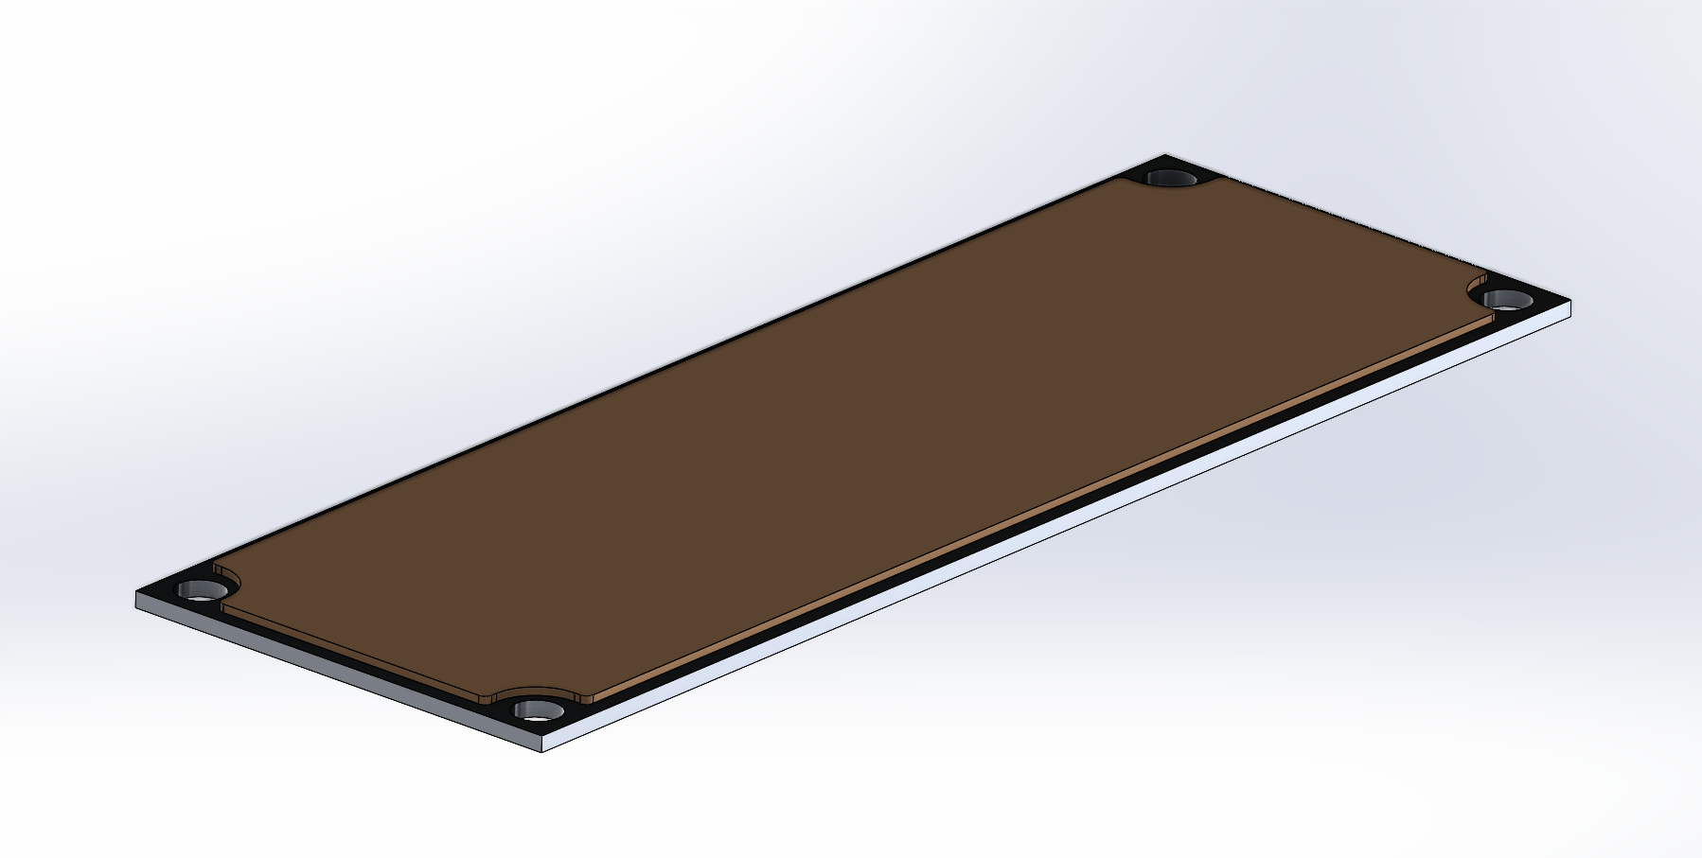
Hotplate Assembly
24, 20W flexible polyimide heater.
AW-6061 Aluminum heat dissipator.
$0.003/mm^2 @ 0.5mm thickness.
~$1.12 per hotplate, assuming waste.
Mills available in the 8 and MEB.
Adhesive flexible heater
Aluminum Heatsink

Slide 5
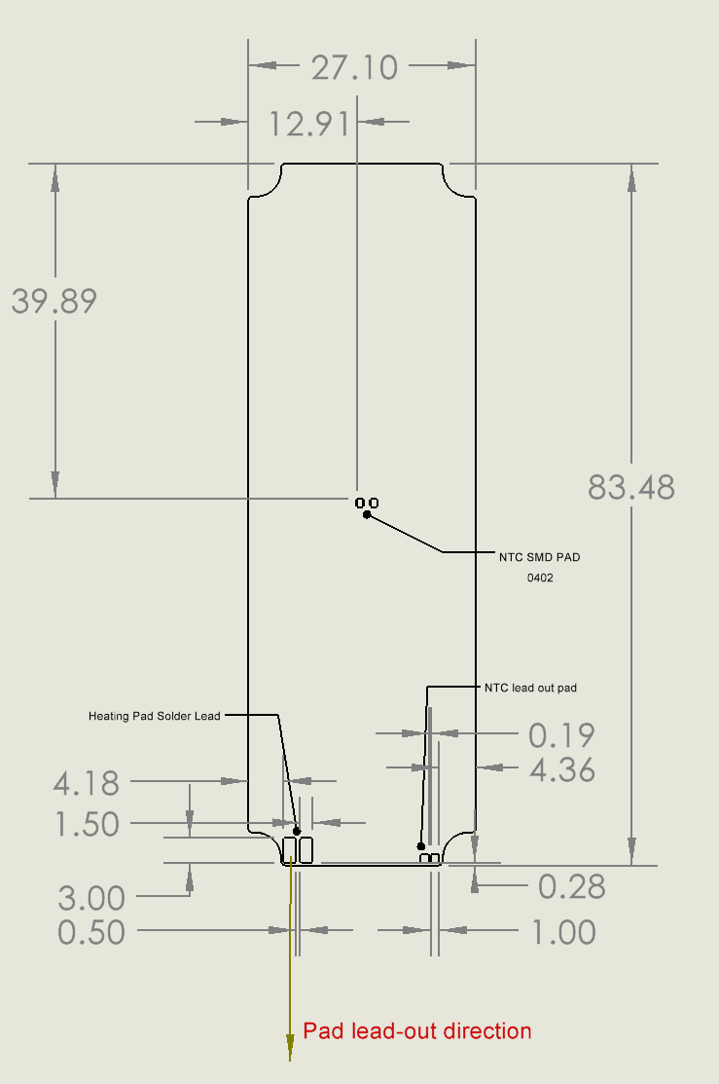
JLCFH – Flexible Heater
3M 468MP temperature-resistant adhesive.
Routing performed by manufacturer.
Switched to 1, 0402 NTC thermistor.
~$5/4 pcs, assembly not included.
Assembly files ready.

Slide 6
Next Steps
Control Hub tweaks.
Emergency stop.
Dev board clearance.
Via stitching on power pours.
Connector sizing.
Tidy-up H&S PCB.

